Slide 1
Matching-Adjusted Indirect Comparisons: Leveraging Individual Participant Data
Society for Medical Decision Making Annual Meeting
Montreal, QC, Canada
October 2018

Slide 2
Timeline for Today’s Workshop
Time | Session | Presenter
2:00 pm – 2:15 pm | Introduction & Agenda | Chris Cameron
2:15 pm – 3:00 pm | Introduction to Matching-Adjusted Indirect comparisons | Chris Cameron
3:00 pm – 3:15 pm | Applied Case Study –Matching-Adjusted Indirect comparisons | Brian Hutton
3:15 pm – 3:30 pm | Break
3:30 pm– 4:00 pm | Applied Case Study –Matching-Adjusted Indirect comparisons | Brian Hutton
4:00 pm – 5:15 pm | Application using R | Tim Disher
5:15 pm – 5:30 pm | Questions and Wrap-up | ALL
All files available here:
Presentation: https://tinyurl.com/y76tdb2n
R Studio Cloud: https://tinyurl.com/yc7lafxq

Slide 3
Introduction to Indirect comparison methods involving summary or ‘aggregate’ data

Slide 4
How to choose a method?
2 Treatments
3 Treatments
>3 Treatments
Direct evidence
Indirect evidence
Naïve indirect comparison
Adjusted indirect comparison
Network meta-analysis (NMA)
Only Summary / Aggregate
Data
Individual Patient Data (IPD) And Summary Data
Unanchored Matching adjusted indirect comparison
Anchored Matching adjusted indirect comparison
Network meta-analysis including IPD (“Prognostic model”)
Propensity score methods (e.g., PSM) or multivariable regression
3-treatment PSM or multivariable regression
Multi-treatment PSM or multivariable regression
Individual Patient Data (IPD) Data Only

Slide 5
Meta-analysis vs. network meta-analysis
Traditional Pairwise’ Approach; Many Drugs=Many MAs
NMA - A Unified Analysis To Make Multiple Pairwise Comparisons Using Direct & Indirect Information
Drug A
Drug C
Drug B
Drug C
Drug A
Drug B
Drug D
Drug C
Drug D
Drug E
Drug C
Drug C
Drug F
Drug C
Drug G
Drug E
Drug G
Drug C
Drug F
Drug E
Drug F
The left depicts the ‘traditional pairwise’ approach...many drugs=many MAs.
The right side depicts NMA; a unified analysis to make multiple pairwise comparisons using direct and indirect information

Slide 6
ITC, MTC or NMA?

Slide 7
Key Assumptions underpinning ITC/NMA?
Trials on the same comparison:
are the results homogeneous or heterogeneous?
Homogeneity
Trials across comparisons:
are these trials similar enough to consider together?
Similarity
Network of many comparisons:
are the results from direct and indirect comparisons consistent?
Consistency

Slide 8
Introduction to Indirect comparison methods involving individual patient data and summary or ‘aggregate’ data

Slide 9
How to choose a method??
2 Treatments
3 Treatments
>3 Treatments
Direct evidence
Indirect evidence
Naïve indirect comparison
Adjusted indirect comparison
Network meta-analysis (NMA)
Only Summary / Aggregate
Data
Individual Patient Data (IPD) And Summary Data
Unanchored Matching adjusted indirect comparison
Anchored Matching adjusted indirect comparison
Network meta-analysis including IPD (“Prognostic model”)
Propensity score methods (e.g., PSM) or multivariable regression
3-treatment PSM or multivariable regression
Multi-treatment PSM or multivariable regression
Individual Patient Data (IPD) Data Only

Slide 10
What is a Matched Adjusted Indirect comparison
A matched adjusted indirect comparison (MAIC) is form of indirect comparison which compares two treatments that have not been compared directly in a clinical trial (typically via a linking treatment)
An MAIC differs from a traditional “adjusted indirect comparison” because it considers a combination of individual patient data (IPD) and summary or “aggregate” data to adjust for differences in characteristics among trials

Slide 11
Unanchored versus Anchored MAIC
Unanchored MAIC
Does not require common comparator
Requires common comparator
This assumption is very strong, and largely considered very difficult to meet. Failure of this assumption leads to an unknown amount of bias in the unanchored estimate.
Less bold assumption compared with unanchored and considered more feasible to meet
Assumes that absolute outcomes can be predicted from the covariates; that is, it assumes that all effect modifiers and prognostic factors are accounted for.
Assumes relative effects can be predicted by adjusting for treatment effect modifiers only
Anchored MAIC

Slide 12
MAIC Methodology
Ensure that inclusion and exclusion criteria are aligned between the two studies (or arms) being compared before statistical analyses are performed.
IPD from a given trial will be matched to the comparator using clinically relevant baseline characteristics that were available from both.
Confirm your trial has ‘broader’ patient population and other studies report sufficient patient characteristics
Subsequently, patients in a given treatment trial will be re-weighted using IPD so that their baseline characteristics match those reported in a given summary level comparator data trial.
A form of propensity score weighting, where patients are weighted by their inverse odds of being in that group versus the other treatment group (derived from the comparator trial for which only aggregate data were available) will be utilized.
The propensity score model will be estimated using the generalized method of moments based on the aggregate data and IPD.

Slide 13
MAIC Methodology
After matching, the average baseline characteristics should be similar between the two studies, and treatment outcomes can be compared across balanced trial populations.
The impact of re-weighting on the available statistical information in the IPD will be expressed through the calculation of the effective sample size (Neff).
Notably, a perfect match of all baseline variables is rarely achieved in MAIC, especially when a large number of variables are included in the matching process.
Neff will be computed as the square of the summed weights divided by the sum of the squared weights. The maximum effective sample size occurs when all patients have equal weight. The occurrence of a small effective sample size can indicate that some patients are receiving extreme weights and that there may be little statistical power to detect differences between treatments.

Slide 14
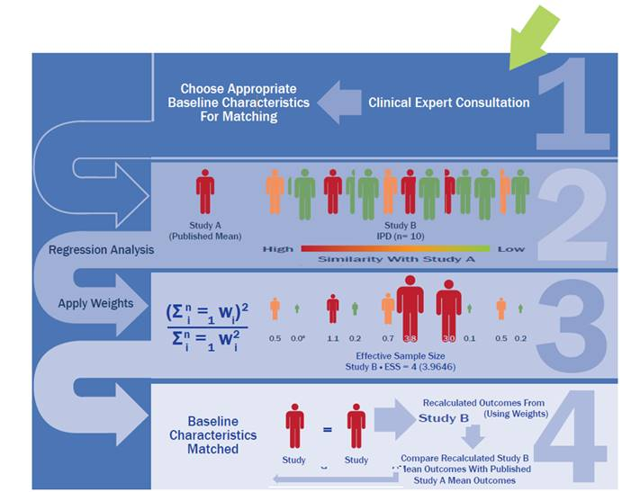
MAIC Methodology

Slide 15
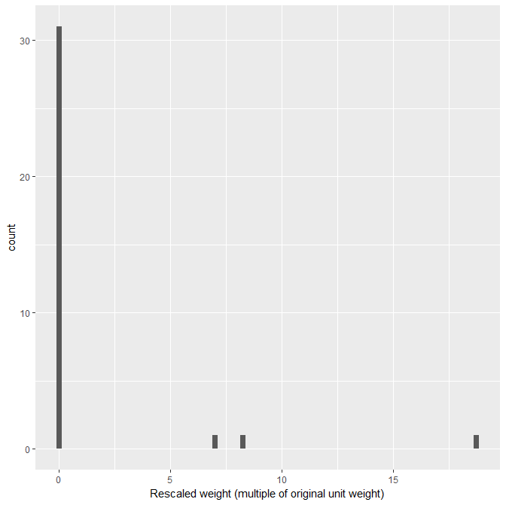
Mock Diagnostic figures
Poorly overlapping population initially;
Effective sample size = 2.46

Slide 16
MAIC Methodology
A Brief Statistical Analysis Plan summarizing the proposed MAIC is typically drafted
A list of potential treatment effect modifiers are included in the Brief Statistical Analysis Plan
Treatment effect factors will be agreed upon in collaboration with clinical advisor(s) and Company
Treatment effect factors will be ranked in order of importance
Treatment effect factor #1 is deemed the most important (largest impact on treatment effect)
Treatment effect factor #N is less important, but could also impact treatment effects

Slide 17
MAIC Scenarios
Exclusion Scenario | Treatment effect modifiers matched
Scenario A | Treatment effect modifier 1 Treatment effect modifier 2 Treatment effect modifier 3 Treatment effect modifier 4 Treatment effect modifier 5 Treatment effect modifier 6 Treatment effect modifier 7 Treatment effect modifier 8 Treatment effect modifier 9
Scenario B | Treatment effect modifier 1 Treatment effect modifier 2 Treatment effect modifier 3 Treatment effect modifier 4 Treatment effect modifier 5 Treatment effect modifier 6 Treatment effect modifier 7 Treatment effect modifier 8
Scenario C | Treatment effect modifier 1 Treatment effect modifier 2 Treatment effect modifier 3 Treatment effect modifier 4 Treatment effect modifier 5 Treatment effect modifier 6 Treatment effect modifier 7
Scenario D | Treatment effect modifier 1 Treatment effect modifier 2 Treatment effect modifier 3 Treatment effect modifier 4 Treatment effect modifier 5 Treatment effect modifier 6
Scenario E | Treatment effect modifier 1 Treatment effect modifier 2 Treatment effect modifier 3 Treatment effect modifier 4 Treatment effect modifier 5
Scenario F | Treatment effect modifier 1 Treatment effect modifier 2 Treatment effect modifier 3 Treatment effect modifier 4
Scenario G | Treatment effect modifier 1 Treatment effect modifier 2 Treatment effect modifier 3
Scenario H | Treatment effect modifier 1 Treatment effect modifier 2
Scenario I | Treatment effect modifier 1
MAIC will be first performed using all treatment effect modifiers
Analyses will be repeated where we drop treatment effect modifier one-by-one in descending order of importance, keeping treatment effect modifiers that are deemed most important.

Slide 18
Potential Treatment effect modifiers
Age
Gender
Race
Body weight
Disease severity…
Note: Treatment effect modifiers must be available in both trials

Slide 19
Ranking of Treatment effect Modifiers
Treatment effect modifier | Clinician Advisor #1 Ordering | Clinician Advisor #2 Ordering | Clinician Advisor #N Ordering | Mean rank Ordering
1
2
3
4
5
6
7
8
9
10

Slide 20
Sample Results Table
Summary of patient characteristics after each matching scenario using IPD from your trial and summary data from RCT #1
 |  |  |  | Scenario
 | Comp | Your Drug | Inclusion/Exclusion Scenario* | A | B | C | D | E | F | G | H | I
Trial Sample size | 433 | 329
Effective Sample Size | NA | NA | NA
N Characteristics matched | NA | NA | NA | 9 | 8 | 7 | 6 | 5 | 4 | 3 | 2 | 1
Baseline Disease severity
Age |  |  |  |  |  |  |  |  |  |  |  | X
Gender |  |  |  |  |  |  |  |  |  |  | X | X
Race |  |  |  |  |  |  |  |  |  | X | X | X
BMI |  |  |  |  |  |  |  |  | X | X | X | X
… |  |  |  |  |  |  |  | X | X | X | X | X
… |  |  |  |  |  |  | X | X | X | X | X | X
… |  |  |  |  |  | X | X | X | X | X | X | X
… |  |  |  |  | X | X | X | X | X | X | X | X
… |  |  |  |  | X | X | X | X | X | X | X | X
* Match to inclusion/exclusion criteria of comparator study

Slide 21
Sample Results Table
Comparison | Scenario | # of Baseline Characteristics Included in Adjustment | Baseline Characteristics Included in MAIC | Effective Sample Size | Odds Risk(95% CI)
 |  |  |  |  | Outcome
Your drug versus Treatment A (RCT #1) | Unadjusted ITC | NA | None | NA
 | Inclusion/Exclusion Criteria Matching Scenario* | NA | None | NA
 | Scenario A | 9 | Factor 1, 2, 3, 4, 5, 6, 7, 8, 9 | X
 | Scenario B | 8 | Factor 1, 2, 3, 4, 5, 6, 7, 8 | .
 | Scenario C | 7 | Factor 1, 2, 3, 4, 5, 6, 7 | .
 | Scenario D | 6 | Factor 1, 2, 3, 4, 5, 6 | .
 | Scenario E | 5 | Factor 1, 2, 3, 4, 5 | .
 | Scenario F | 4 | Factor 1, 2, 3, 4 | .
 | Scenario G | 3 | Factor 1, 2, 3 | .
 | Scenario H | 2 | Factor 1, 2 | .
 | Scenario I | 1 | Factor 1 | .
* Match to inclusion criteria of comparator study

Slide 22
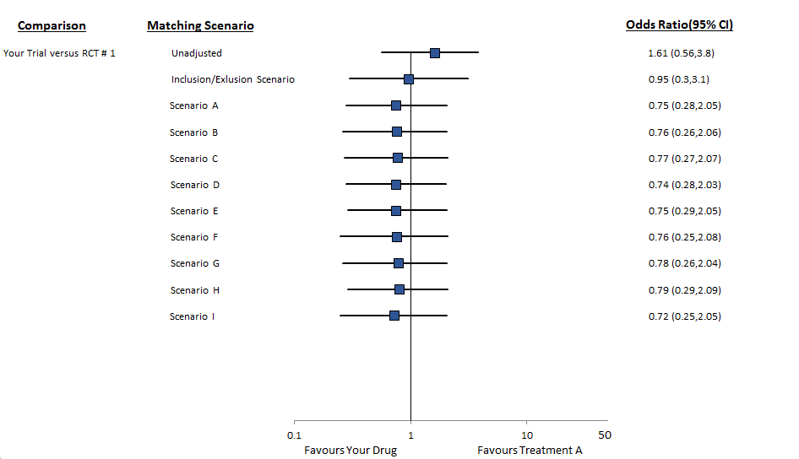
Sample Forest Plot – One comparison

Slide 23
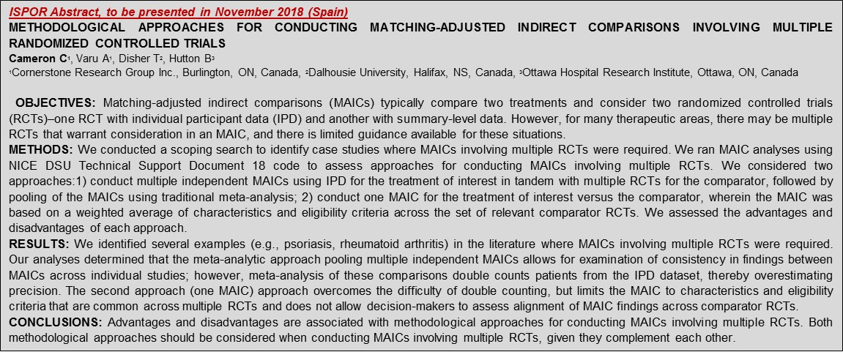
Combining MAIC Analyses
MAIC may be conducted on each IPD-summary level data combination for each outcome
Your trial vs RCT #1, Treatment A
Your trial vs RCT #2, Treatment A
Your trial vs RCT #3, Treatment A
A meta-analysis may be performed in order to pool the MAIC results into a single point estimate for each outcome
Risk of multiple counting (methods underway to address this issue)

Slide 24
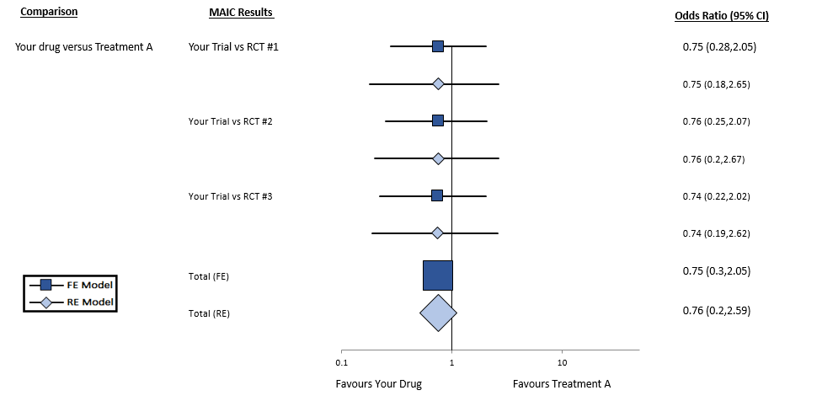
Sample Forest Plot of MA of MAIC

Slide 25
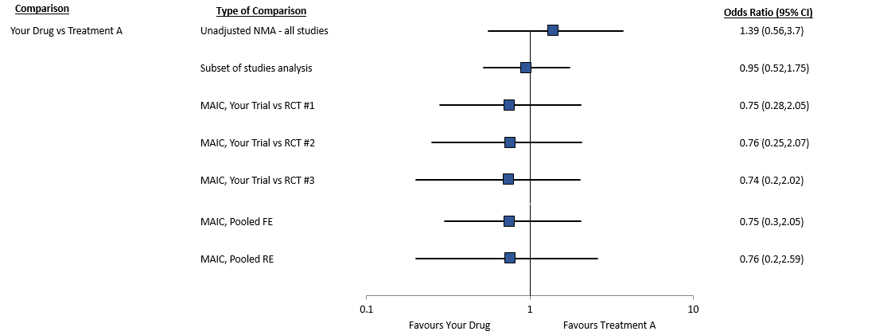
Sample Forest Plot Comparing findings with NMA

Slide 26
Use of MAIC by HTA Bodies and Payers
The application of MAIC has increased in recent years
If done properly, considered more methodologically rigorous than analyses based solely on summary or “aggregate data”
HTA bodies in Canada and globally have seen an increasing number of submissions employing this methodology, especially in oncology
Payers and HTA bodies are more willing to accept this methodology if:
Rationale clearly stated, e.g., imbalance in treatment effect modifiers, network is sparse and otherwise “disconnected” in absence of methodology
Manufacturer clearly discusses heterogeneity among trials and need for leveraging IPD data to adjust for differences
Analytic methods are transparent, e.g., statistical methods are reproducible and presented in a clear and concise manner
Adhere to best practices for reporting, e.g., NICE Guidance

Slide 27
MAICs Submitted to HTA in Multiple Disease Areas
Based on an ISPOR 2015 presentation on indirect comparisons for single-arm trials or trials without common comparator arms by Swallow et al.

Slide 28
Thank you

